Slide 1
Inheritance in JAVA

Slide 2
Inheritance in Java is a mechanism in which one object acquires all the properties and behaviors of a parent object.
The idea behind inheritance in Java is that we can create new classes that are built upon existing classes.
When we inherit methods from an existing class, we can reuse methods and fields of the parent class. However, we can add new methods and fields in your current class also.

Slide 3
Why Do We Need Java Inheritance?
Code Reusability
Method Overriding
Abstraction

Slide 4
The syntax of Java Inheritance
class Subclass-name extends Superclass-name
{
//methods and fields
}

Slide 5
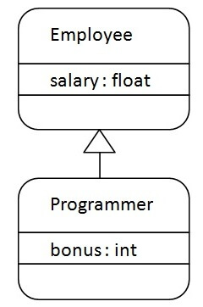

Slide 6
class Employee{
float salary=40000;
}
class Programmer extends Employee{
int bonus=10000;
public static void main(String args[]){
Programmer p=new Programmer();
System.out.println(p.salary);
System.out.printlnp.bonus);
}
}

Slide 7
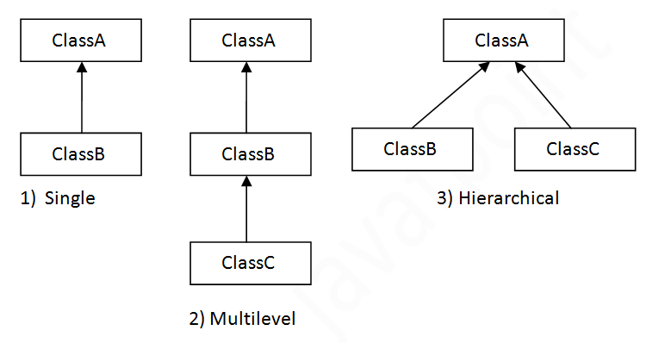

Slide 8
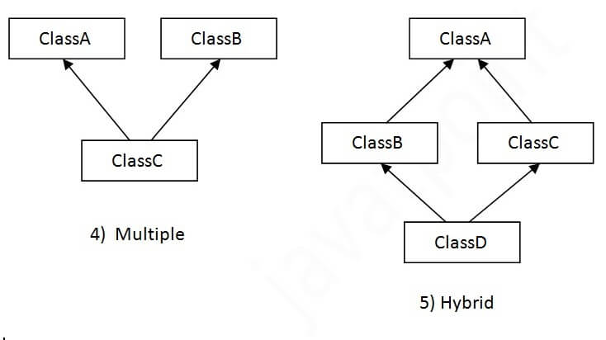

Slide 9
class Animal{
void eat(){System.out.println("eating...");}
}
class Dog extends Animal{
void bark(){System.out.println("barking...");}
}
class BabyDog extends Dog{
void weep(){System.out.println("weeping...");}
}

Slide 10
class TestInheritance2
{
public static void main(String args[])
{
BabyDog d=new BabyDog();
d.weep();
d.bark();
d.eat();
}
}

Slide 11
class Animal{
void eat()
{
System.out.println("eating...");}
}
class Dog extends Animal{
void bark()
{
System.out.println("barking...");}
}
class Cat extends Animal{
void meow()
{
System.out.println("meowing...");}
}

Slide 12
class TestInheritance3{
public static void main(String args[])
{
Cat c=new Cat();
c.meow();
c.eat();
//c.bark();//C.T.Error
}
}

Slide 13
Why multiple inheritance is not supported in Java?
To reduce the complexity and simplify the language, multiple inheritance is not supported in java.

Slide 14
Suppose there are three classes A, B, and C. The C class inherits A and B classes.
If A and B classes have the same method and we call it from child class object, there will be ambiguity to call the method of A or B class.
Since compile-time errors are better than runtime errors, Java renders compile-time error if you inherit 2 classes.
So whether you have same method or different, there will be compile time error.

Slide 15
class A{
void msg(){System.out.println("Hello");}
}
class B{
void msg(){System.out.println("Welcome");}
}
class C extends A,B{//suppose if it were
public static void main(String args[]){
C obj=new C();
obj.msg();//Now which msg() method would be invoked?
}
}

Slide 16
However, Java supports multiple inheritance through interfaces, where a class can implement multiple interfaces.

Slide 17
Abstract Class
A class that is declared with the abstract keyword is known as an abstract class in Java.
It can have abstract and non-abstract methods (method with the body).

Slide 18
An abstract class in Java acts as a partially implemented class that itself cannot be instantiated.
It exists only for subclassing purposes, and provides a template for its subcategories to follow.
Abstract classes can have implementations with abstract methods.
Abstract methods are declared to have no body, leaving their implementation to subclasses.

Slide 19
Points to Remember
An abstract class must be declared with an abstract keyword.
It can have abstract and non-abstract methods.
It cannot be instantiated.
It can have constructors and static methods also.
It can have final methods which will force the subclass not to change the body of the method.

Slide 20
public abstract class Shape {
public abstract double area();
public void display() {
System.out.println("This is a shape.");
}
}

Slide 21
abstract class Bike{
abstract void run();
}
class Honda4 extends Bike{
void run(){
System.out.println("running safely");
}
public static void main(String args[]){
Bike obj = new Honda4();
obj.run();
}
}

Slide 22
Interface
Interface is a reference type that acts as a blueprint for classes.
It contains abstract methods (methods without a body) and constants.
An interface is used to achieve abstraction and multiple inheritance in Java.

Slide 23
Key Characteristics of an Interface
Abstract Methods Only: By default, all methods in an interface are public and abstract (before Java 8).
Constant Fields: Variables in an interface are implicitly public, static, and final.
No Constructors: Interfaces cannot have constructors since they cannot be instantiated.

Slide 24
Key Characteristics of an Interface
Multiple Inheritance Support: A class can implement multiple interfaces, overcoming Java’s limitation of single inheritance.
Implementation by Classes: A class must implement all methods of an interface unless it is an abstract class.

Slide 25
Defining an Interface
// Defining an interface
interface Animal {
void makeSound();
}

Slide 26
// Implementing the interface
class Dog implements Animal {
public void makeSound() {
System.out.println("Woof! Woof!");
}
}
public class InterfaceExample {
public static void main(String[] args) {
Animal myDog = new Dog();
myDog.makeSound(); // Output: Woof! Woof!
}
}

Slide 27
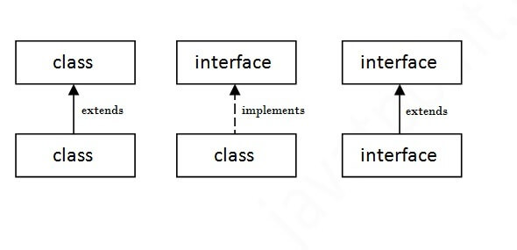

Slide 28
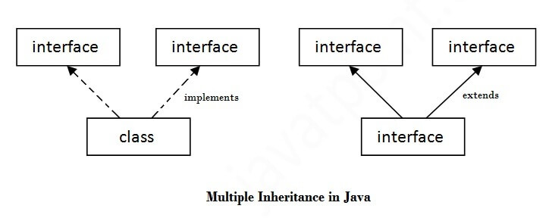
Multiple Inheritance in Java

Slide 29
interface Printable{
void print();
}
interface Showable{
void show();
}

Slide 30
class A7 implements Printable,Showable{
public void print(){System.out.println("Hello");}
public void show(){System.out.println("Welcome");}
public static void main(String args[]){
A7 obj = new A7();
obj.print();
obj.show();
}
}

Slide 31
Points | Abstract Class | Interface
Definition | Cannot be instantiated; contains both abstract (without implementation) and concrete methods (with implementation) | Specifies a set of methods a class must implement; methods are abstract by default.
Implementation Method | Can have both implemented and abstract methods. | Methods are abstract by default; Java 8, can have default and static methods.
Inheritance | class can inherit from only one abstract class. | A class can implement multiple interfaces.
Access Modifiers | Methods and properties can have any access modifier (public, protected, private). | Methods and properties are implicitly public.
Variables | Can have member variables (final, non-final, static, non-static). | Variables are implicitly public, static, and final (constants).

Slide 32
Method Overriding in Java
If subclass (child class) has the same method as declared in the parent class, it is known as method overriding in Java.
In other words, If a subclass provides the specific implementation of the method that has been declared by one of its parent class, it is known as method overriding.

Slide 33
Rules for Java Method Overriding
Same Method Name: The overriding method in the subclass must have the same name as the method in the superclass that it is overriding.
Same Parameters: The overriding method must have the same number and types of parameters as the method in the superclass. This ensures compatibility and consistency with the method signature defined in the superclass.
IS-A Relationship (Inheritance): Method overriding requires an IS-A relationship between the subclass and the superclass. This means that the subclass must inherit from the superclass, either directly or indirectly, to override its methods.

Slide 34
Same Return Type : The return type of the overriding method can be the same as the return type of the overridden method in the superclass.
Access Modifier Restrictions: The access modifier of the overriding method must be the same as or less restrictive than the access modifier of the overridden method in the superclass.
No Final Methods: Methods declared as final in the superclass cannot be overridden in the subclass. This is because final methods cannot be modified or extended.
No Static Methods: Static methods in Java are resolved at compile time and cannot be overridden. Instead, they are hidden in the subclass if a method with the same signature is defined in the subclass.

Slide 35
class Vehicle{
void run(){System.out.println("Vehicle is running");}
}
class Bike2 extends Vehicle{
void run(){System.out.println("Bike is running safely");}
public static void main(String args[]){
Bike2 obj = new Bike2();//creating object
obj.run();//calling method
}
}

Slide 36
class Bank{
int getRateOfInterest()
{
return 0;
}
}
class SBI extends Bank{
int getRateOfInterest()
{
return 8;
}
}
class ICICI extends Bank{
int getRateOfInterest()
{
return 7;
}
}
class AXIS extends Bank{
int getRateOfInterest()
{
return 9;
}
}

Slide 37
class Test2
{
public static void main(String args[]){
SBI s=new SBI();
ICICI i=new ICICI();
AXIS a=new AXIS();
s.o.p(s.getRateOfInterest());
s.o.p(i.getRateOfInterest());
s.o.p(a.getRateOfInterest());
}
}

Slide 38
Object Class and Overriding Its Methods in Java
In Java, the Object class is the root of the class hierarchy. Every class in Java implicitly inherits from the Object class.
It is part of java.lang package and provides default implementations of fundamental methods that every Java object inherits.

Slide 39
Common Methods of the Object Class
Method Signature Purpose
public String toString() Returns a string representation of the object.
public boolean equals(Object obj) Checks if two objects are equal.
public int hashCode() Returns a hash code for the object.
protected Object clone() Creates a new object that is a copy of the original.
protected void finalize() Called by the garbage collector before an object is destroyed.

Slide 40
Overriding toString()
class Employee {
String name;
int id;
Employee(String name, int id) {
this.name = name;
this.id = id;
}
// Overriding toString() method
@Override
public String toString() {
return "Employee{name='" + name + "', id=" + id + "}";
}
}

Slide 41
public class ToStringExample {
public static void main(String[] args) {
Employee emp = new Employee("John", 101);
S.o.p (emp);
}
}

Slide 42
Overriding equals()
The equals() method checks if two objects are equal. By default, it compares object references.
We override it to compare objects based on their fields.

Slide 43
class Person {
String name;
Person(String name) {
this.name = name;
}
@Override
public boolean equals(Object obj) {
Person p = (Person) obj;
return this.name.equals(p.name);
}
}
public class EqualsExample {
public static void main(String[] args) {
Person p1 = new Person("Alice");
Person p2 = new Person("Alice");
Person p3 = new Person("Bob");
System.out.println(p1.equals(p2));
System.out.println(p1.equals(p3));
}
}

Slide 44
Overriding finalize()
The finalize() method is called before an object is destroyed by the garbage collector.
It can be used to release resources.

Slide 45
class Employee {
int id;
Employee(int id) {
this.id = id;
}
@Override
protected void finalize() throws Throwable {
System.out.println("Employee object with id " + id + " is being garbage collected.");
}
}
public class FinalizeExample {
public static void main(String[] args) {
Employee emp = new Employee(106);
emp = null; // Make eligible for garbage collection
System.gc(); // Request JVM to run garbage collector
}
}

Slide 46
Overriding hashcode()
The hashCode() method in Java returns an integer that represents an object’s memory address or a computed hash value.
It is primarily used in hash-based collections like HashMap, HashSet, and HashTable for efficient storage and retrieval of objects.

Slide 47
Why Override hashCode()?
When you override equals(), you must also override hashCode() to maintain consistency. According to Java's contract:
If two objects are equal (equals() returns true), their hash codes must be the same.
If two objects are not equal, their hash codes can be different (but not necessarily).

Slide 48
class Person {
int id;
public Person(int id) {
this.id = id;
}
@Override
public int hashCode() {
return id;
// Simple hash function using ID
}
}
public class Main {
public static void main(String[] args) {
Person p1 = new Person(101);
Person p2 = new Person(102);
s.o.p ("HashCode of p1: " + p1.hashCode());
s.o.p ("HashCode of p2: " + p2.hashCode());
}
}

Slide 49
Java Package
A java package is a group of similar types of classes, interfaces and sub-packages.
Package in java can be categorized in two form
built-in package
user-defined package.

Slide 50
Packages are used for:
Prevent naming conflicts by allowing classes with the same name to exist in different packages,like college.staff.cse.Employee and college.staff.ee.Employee.
They make it easier to organize, locate, and use classes, interfaces, and other components.

Slide 51
Packages also provide controlled access for Protected members that are accessible within the same package and by subclasses.
Also for default members (no access specifier) that are accessible only within the same package.

Slide 52
Working of Java Packages
Directory Structure: Package names and directory structures are closely related.
For example, if a package name is college.staff.cse, then three directories are, college, staff, and cse, where cse is inside staff, and staff is inside the college.

Slide 53
Built-in Packages
Some of the commonly used built-in packages are:
java.lang: Contains language support classes(e.g classes which defines primitive data types, math operations). This package is automatically imported.
java.io: Contains classes for supporting input / output operations.
java.util: Contains utility classes which implement data structures like Linked List, Dictionary and support ; for Date / Time operations.

Slide 54
java.applet: Contains classes for creating Applets.
java.awt: Contain classes for implementing the components for graphical user interfaces (like button , ;menus etc). )
java.net: Contain classes for supporting networking operations.

Slide 55
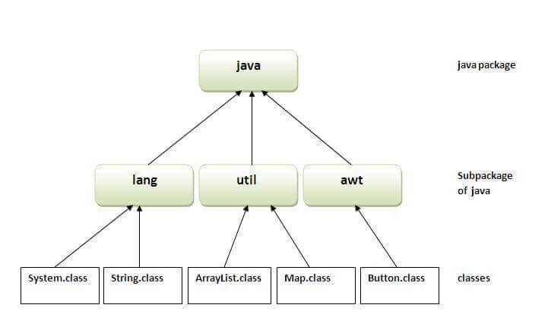

Slide 56
How to access package from another package?
There are three ways to access the package from outside the package.
1. Import a specific class:
import java.util.Vector;
2. Import all classes from a package:
import java.util.*;
Note : This imports all classes and interfaces from the java.util package but does not include sub-packages.

Slide 57
3. Using fully qualified name
Ex. Java.util.Scanner sc = new java.util.Scanner(System.in)
If you use fully qualified name then only declared class of this package will be accessible.
Now there is no need to import.
But you need to use fully qualified name every time when you are accessing the class or interface.

Slide 58
User-defined Packages
1. Create the Package:
First we create a directory myPackage (name should be same as the name of the package).
Then create the MyClass inside the directory with the first statement being the package names.

Slide 59
// Name of the package must be same as the directory
// under which this file is saved
package myPackage;
public class MyClass
{
public void getNames(String s)
{
System.out.println(s);
}
}

Slide 60
2. Use the Class in Program:
// import 'MyClass' class from 'names' myPackage
import myPackage.MyClass;
public class Geeks {
public static void main(String args[]) {
// Initializing the String variable
// with a value
String s = “Hello";
// Creating an instance of class MyClass in
// the package.
MyClass o = new MyClass();
o.getNames(s);
}
}

